Slide 1
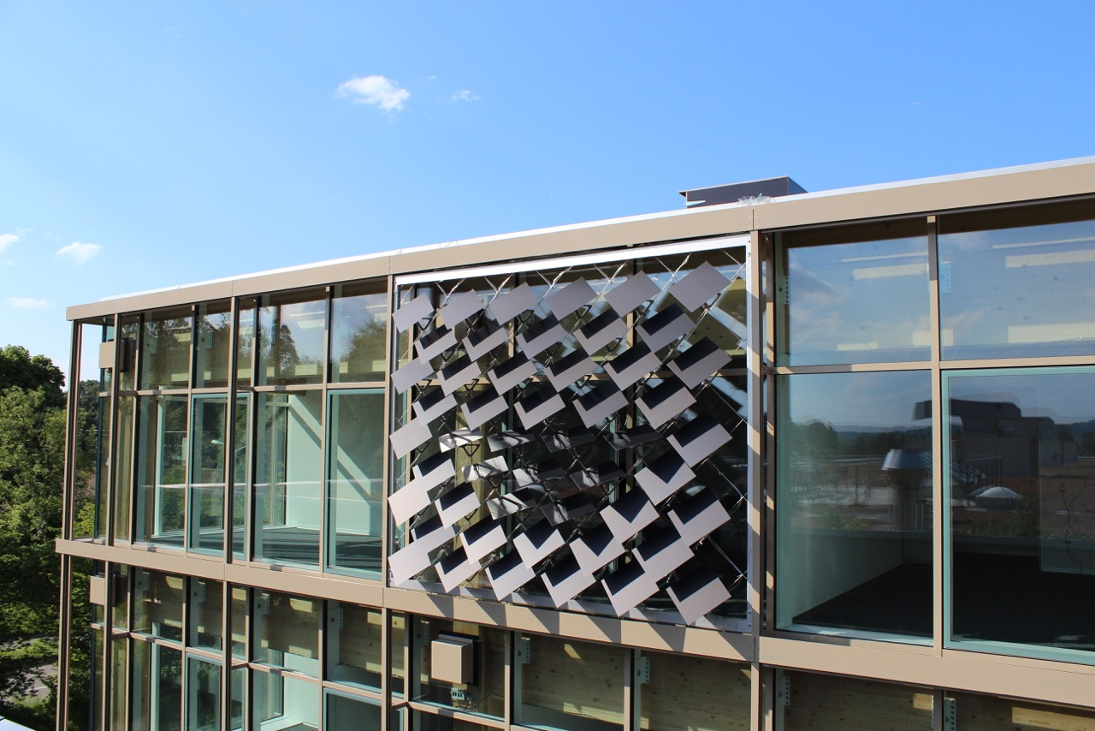
Numerical Analysis of the Adaptive Solar Façade
Jeremias Schmidli
Supervisor: Prageeth Jayathissa

Slide 2
The Adaptive Solar Façade (ASF)
Individually Actuated Panels
Combines Dynamic Shading with PV-Electricity Production
Needs to be Optimized for Cooling, Heating, Lighting and PV-Electricity Production

Slide 3
Overview
Introduction
Problem Description
Methodology
Results and Discussion
Conclusions and Outlook

Slide 4
Problem Description
Optimization Problem
Minimize: C + H + L – PV
C = Cooling Electricity Demand
H = Heating Electricity Demand
L = Lighting Electricity Demand
PV = Photovoltaic Electricity Production

Slide 5
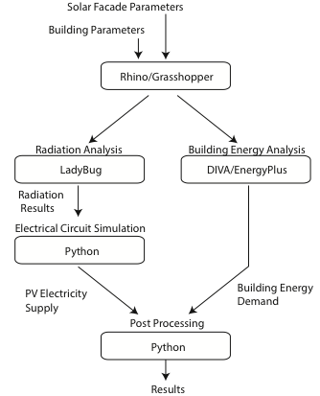
Methodology
Combination Of Different Tools To Achieve Optimal Results
Minimize: C + H + L – PV
Notes:
Add minimization problem

Slide 6
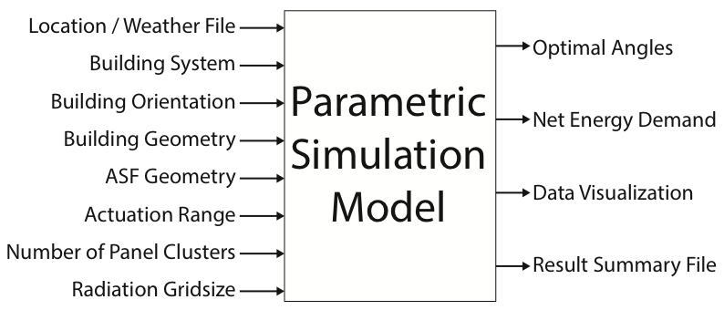
Parametric Model
Notes:
Add minimization problem

Slide 7
Case Study
Single Zone Office
Simulation for One Year
Weather File for Kloten-Zurich
Heating COP: 4
Cooling COP: 3
Lighting Load: 11.74 W/m²
Infiltration Rate: 1/h
Notes:
Add minimization problem

Slide 8
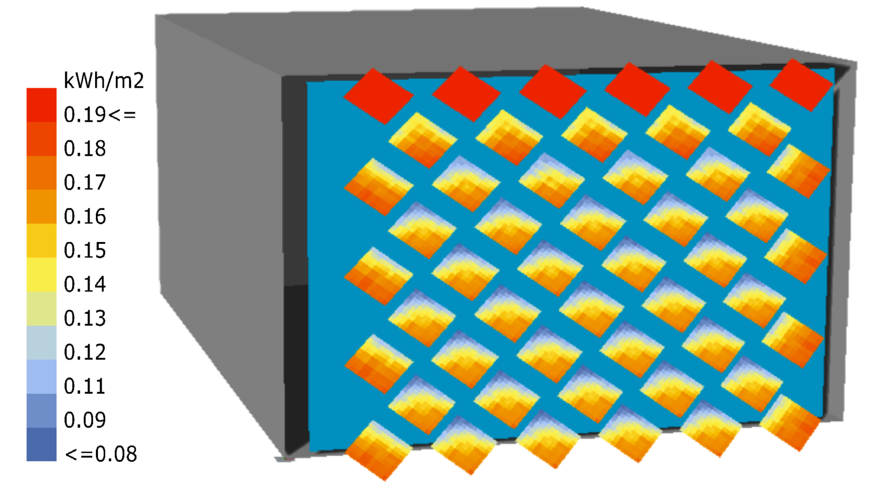
Radiation and PV analysis
(Collaboration with Johannes)
Radiation Analysis with Ladybug
Includes Self-Shading
Detailed PV simulation with Python
Insolation from 11:00-12:00 on June 16

Slide 9
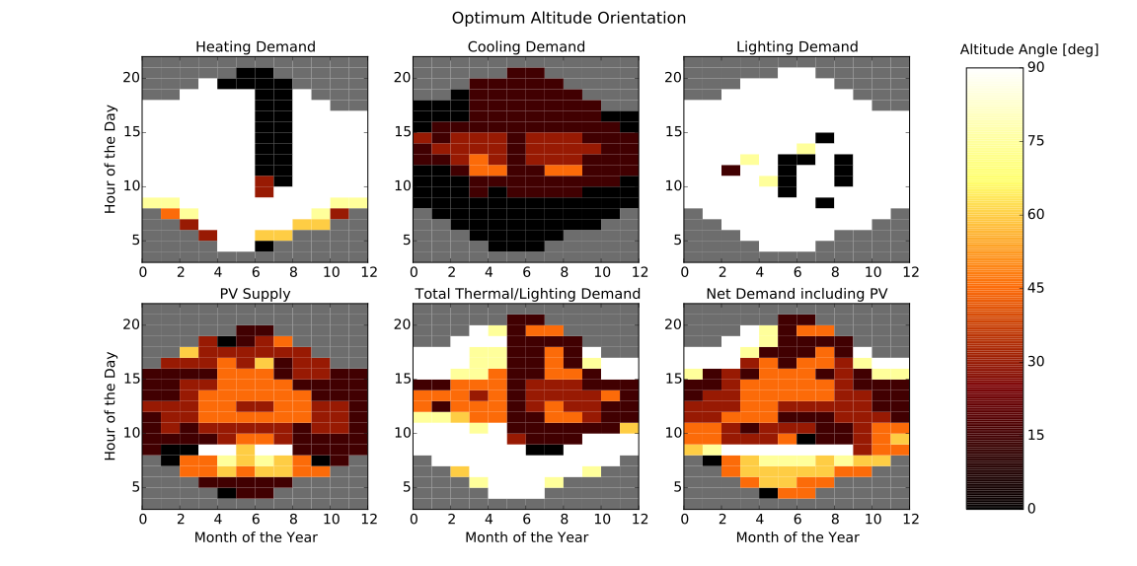
Optimum Altitude Angles of Panels

Slide 10
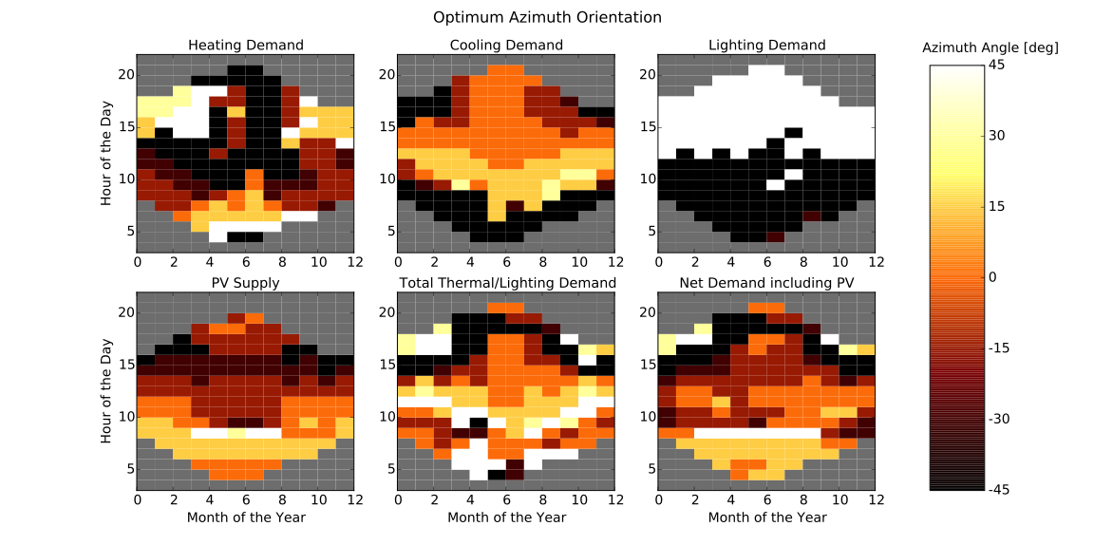
Optimum Azimuth Angles of Panels

Slide 11
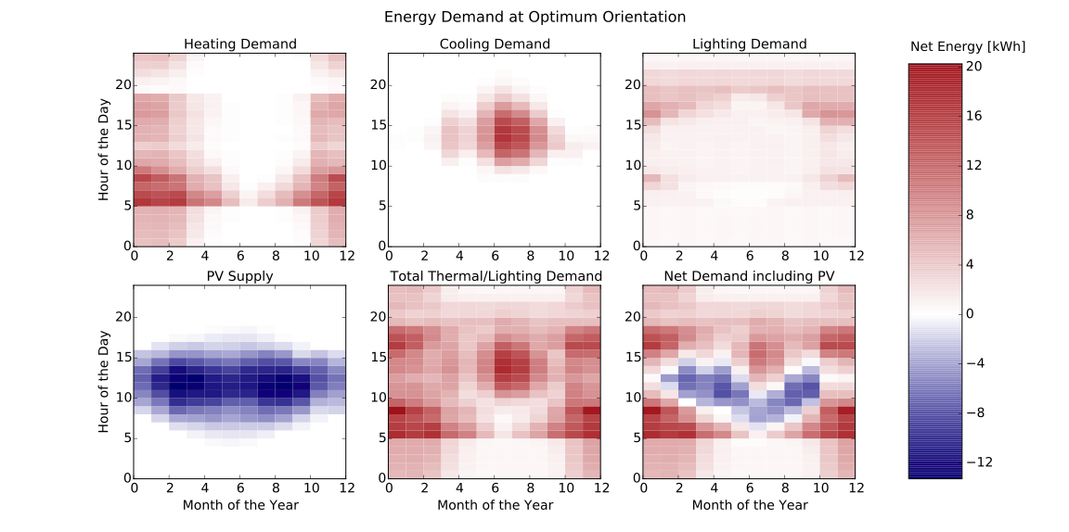
Net Energy Demand at Optimum Orientation

Slide 12
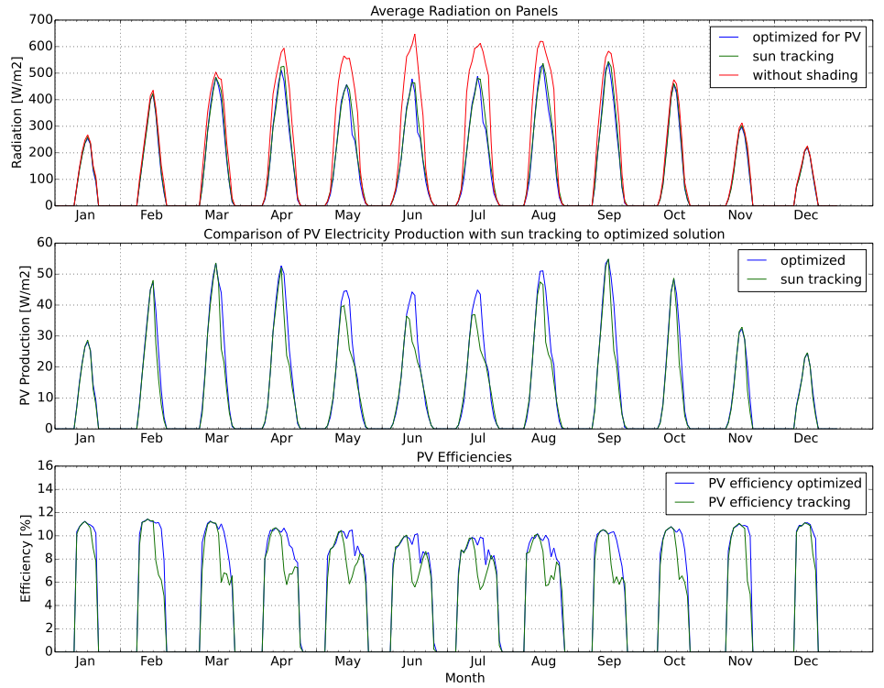
PV: Sun-Tracking vs. Optimization
- Similar Radiation
- Large Loss due to Shading
- Higher Electricity Production for Optimized Solution
- Higher Efficiency with Optimized Solution

Slide 13
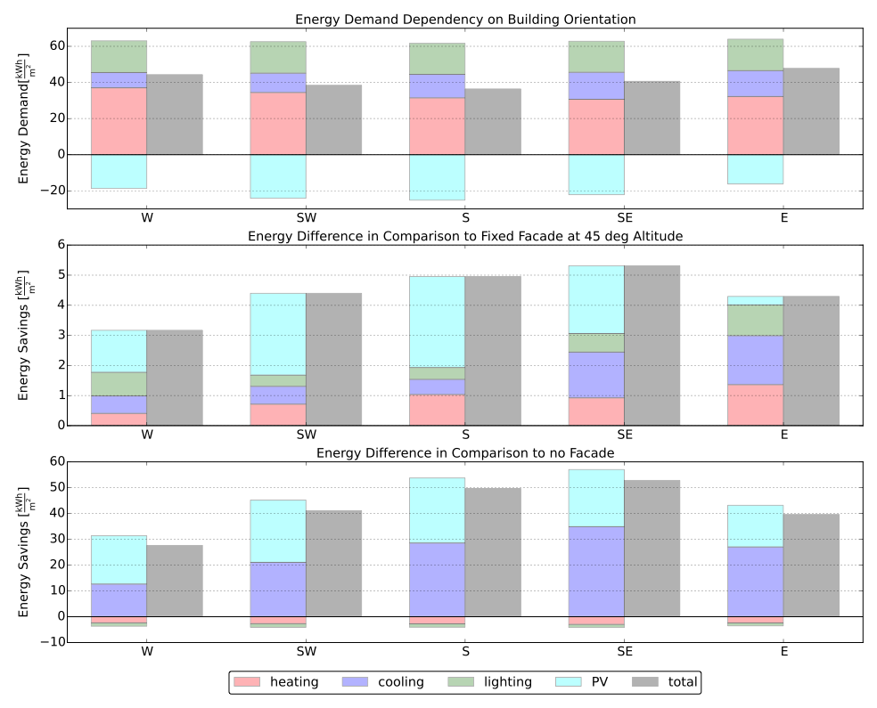
Building Orientation Performance
South facing office performs best
Highest benefit from ASF for south-east facing facade due to cooling

Slide 14
Conclusions
Developed Simulation Framework for the ASF
Successfully combine PV-Electricity Production with Building Energy Demand
Optimal Angles for Single Cluster Found

Slide 15
Outlook
Development of RC-Building Energy Simulation Tool (Collaboration with Mario and Amr)
Include detailed Efficiency Analysis of PV-Electricity Production (Collaboration with Johannes)
Include Energy-Use for Actuation in Simulation
Analyze Results for different Regions and Building Typologies
Use Multiple Clusters of PV-Panels

Slide 16
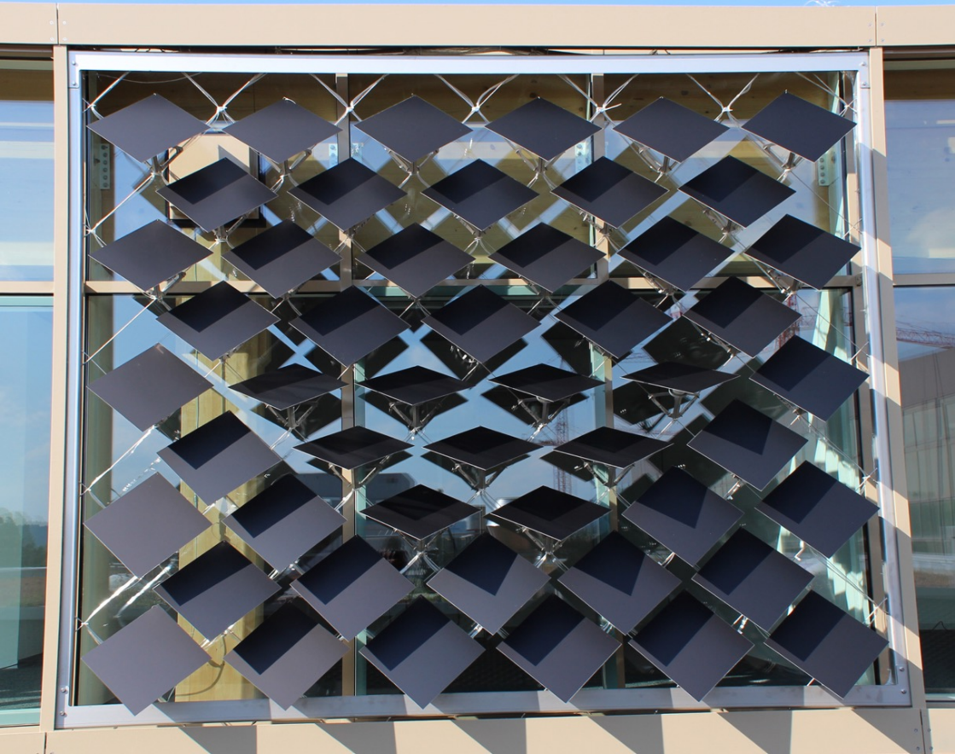
Questions?
https://github.com/architecture-building-systems/ASF_Simulation

Slide 17
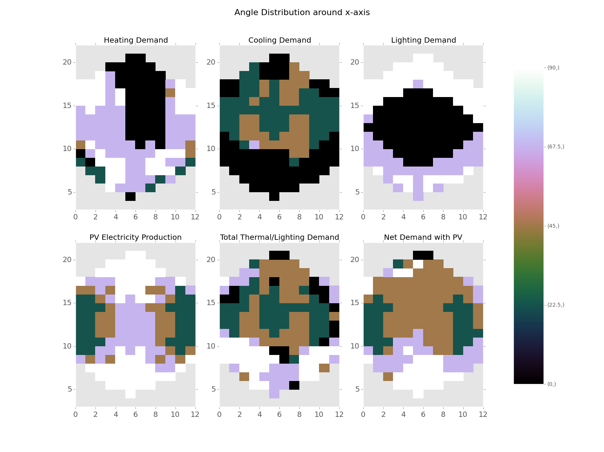
Developed Simulation Framework for the ASF
Optimum Angle Combinations Found
Possibility to Include PV-Electricity Production

Slide 18
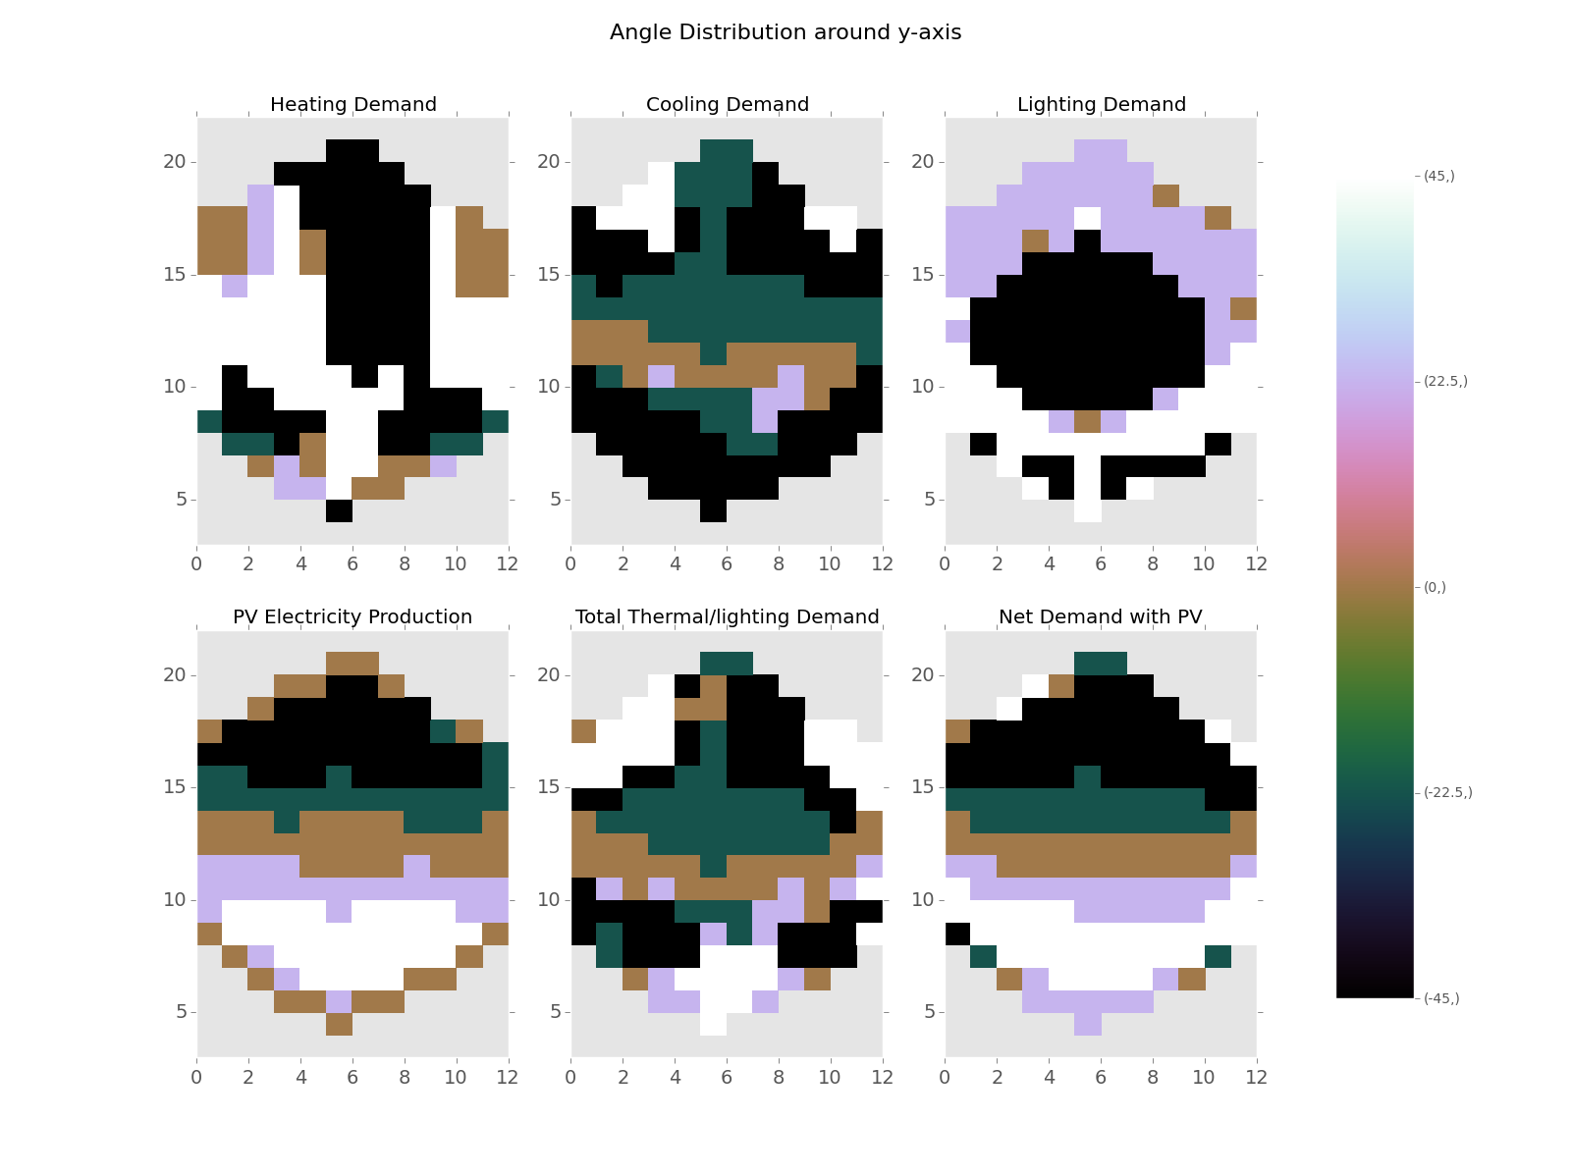
Developed Simulation Framework for the ASF
Optimum Angle Combinations Found
Possibility to Include PV-Electricity Production

Slide 19
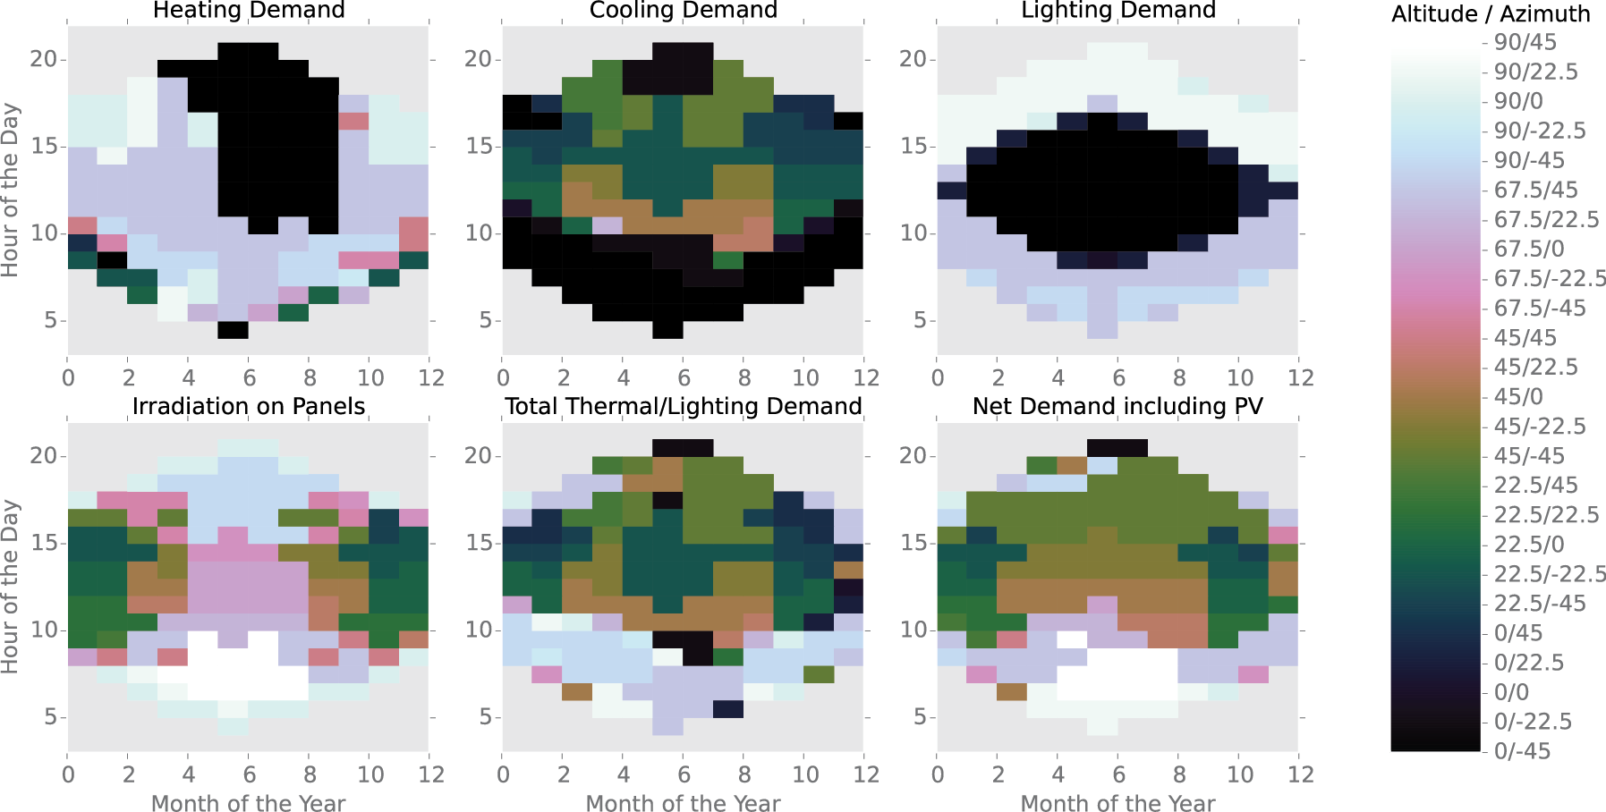

Slide 20
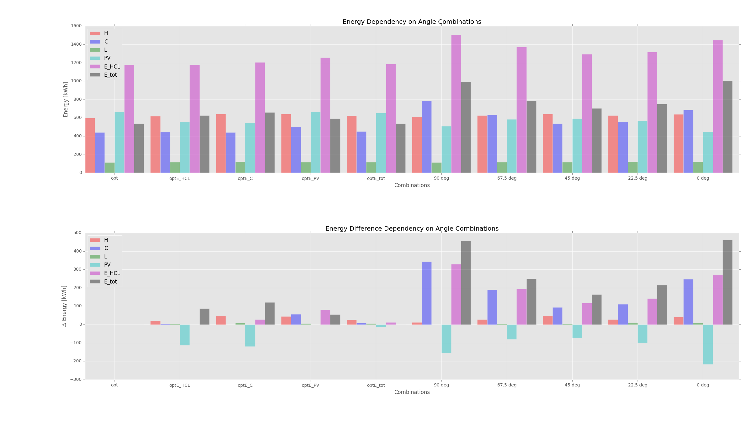
Heating COP = 3 Cooling COP = 3 Lighting = 3 W/m2 PV-efficiency = 0.072

Slide 21
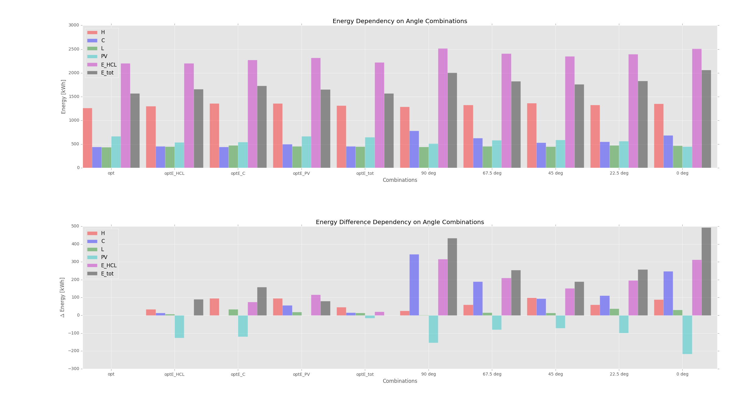
Heating COP = 0.85 Cooling COP = 3 Lighting = 11.74 W/m2 PV-efficiency = 0.072

Slide 22
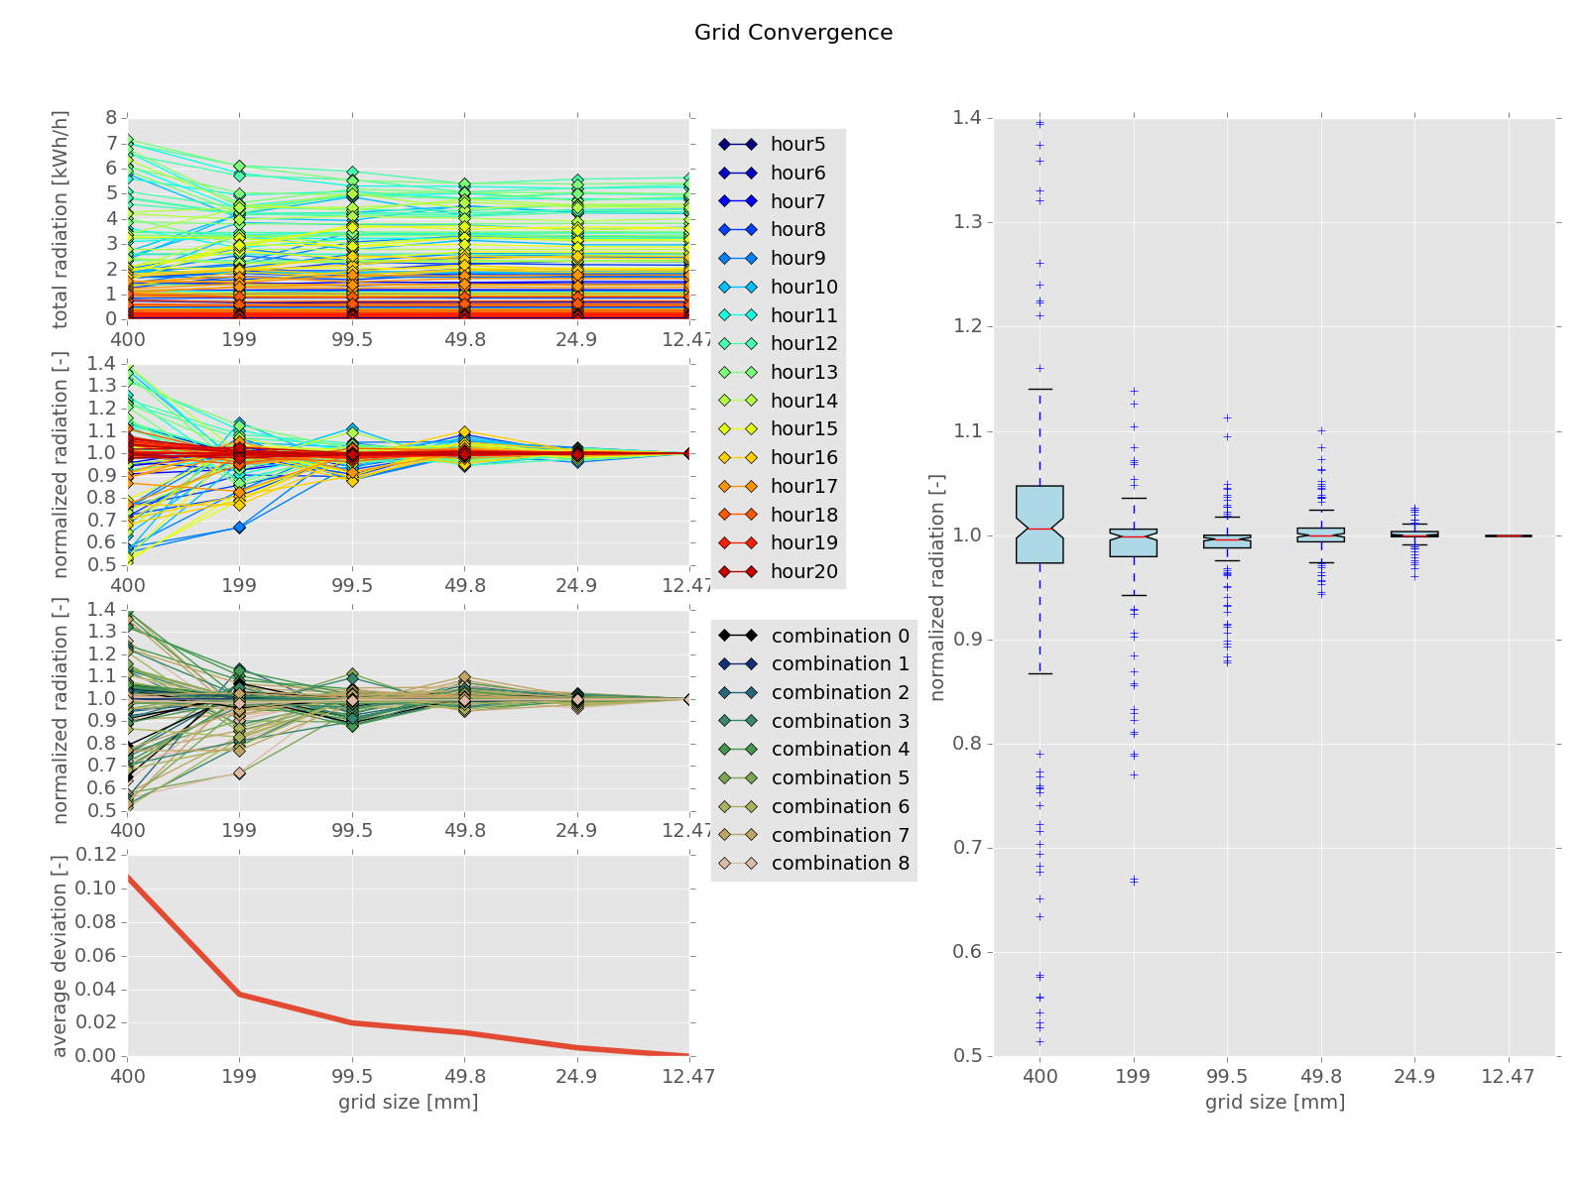
Conclusions
Developed Simulation Framework for the ASF
Optimum Angle Combinations Found
Possibility to Include PV-Electricity Production

Slide 23
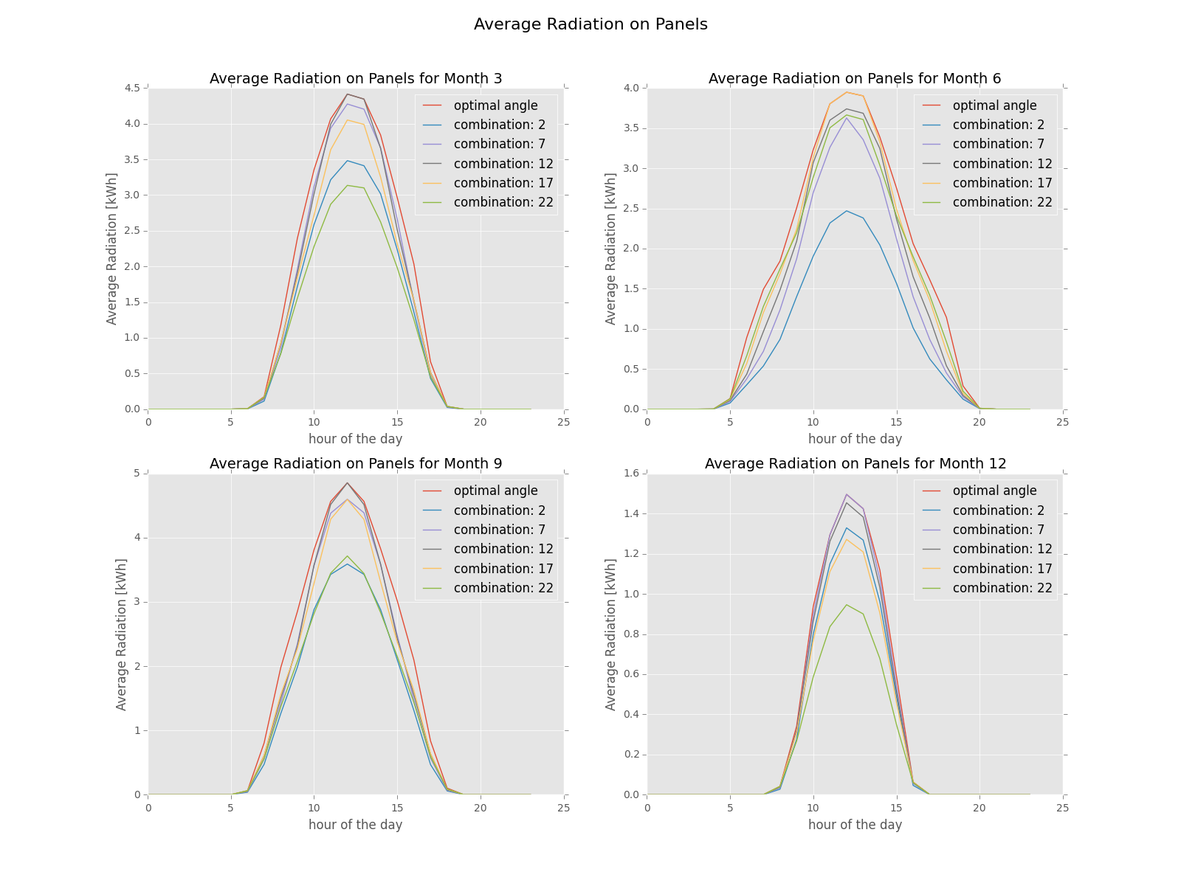
Conclusions
Developed Simulation Framework for the ASF
Optimum Angle Combinations Found
Possibility to Include PV-Electricity Production

Slide 24
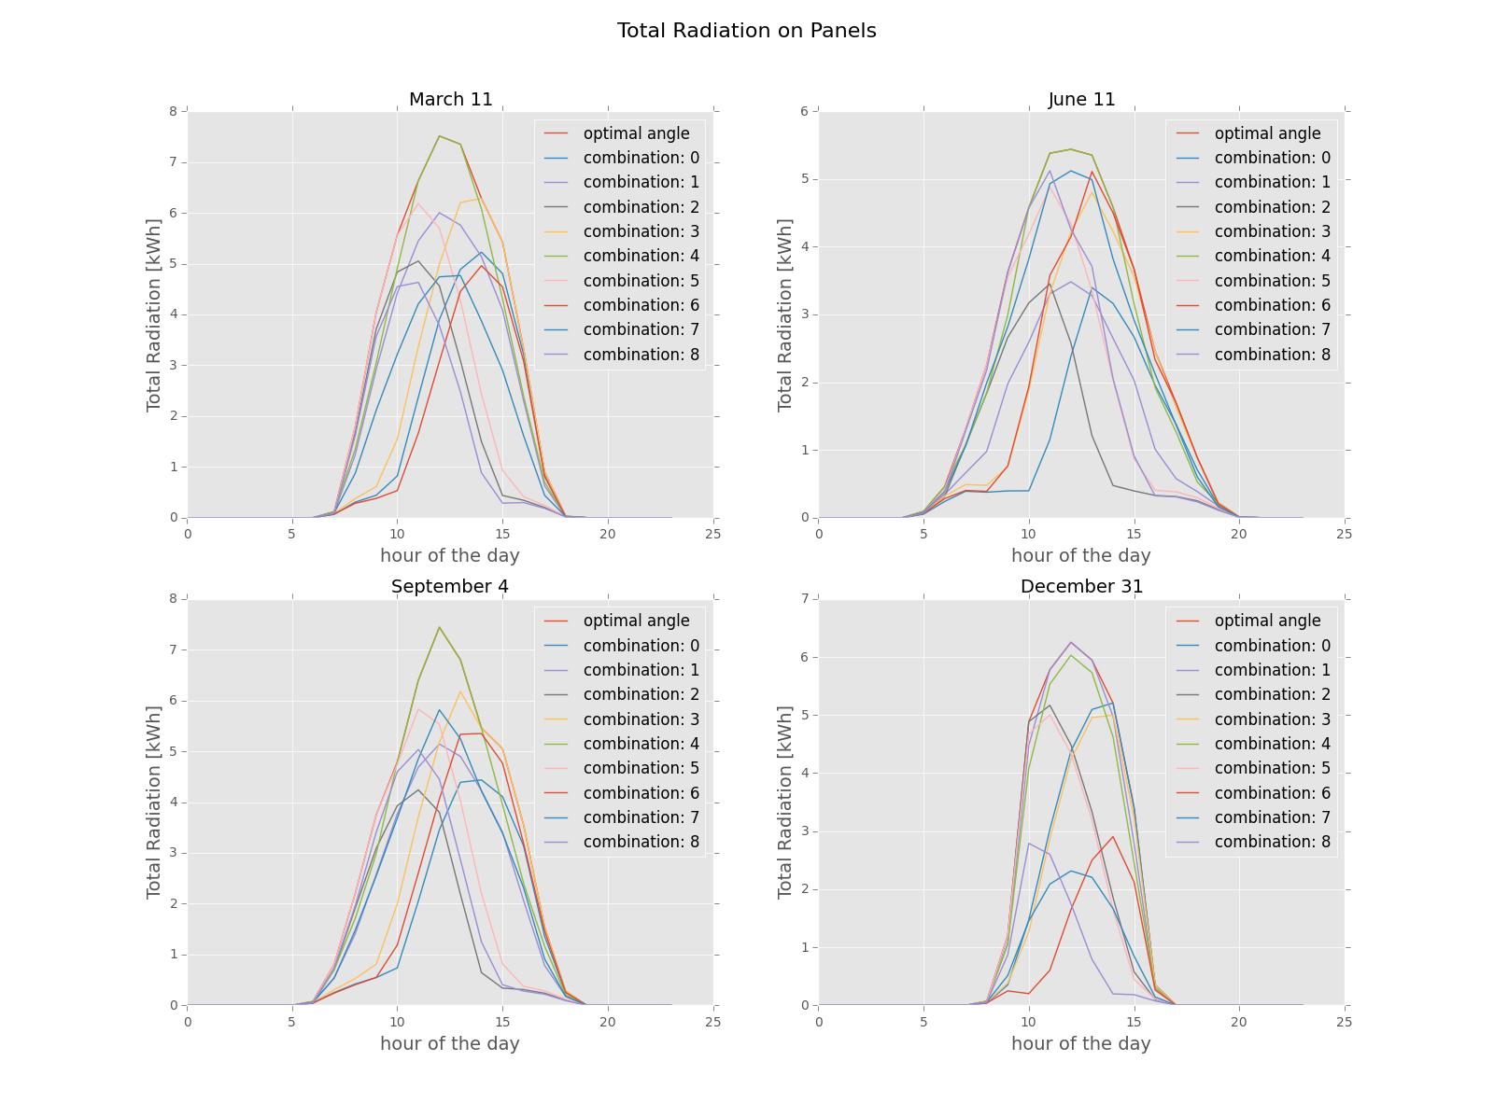
Conclusions
Developed Simulation Framework for the ASF
Optimum Angle Combinations Found
Possibility to Include PV-Electricity Production

